Slide 1
Identification of Archaea Associated with Recovery from Antibiotic Exposure
Anne Lemek

Slide 2
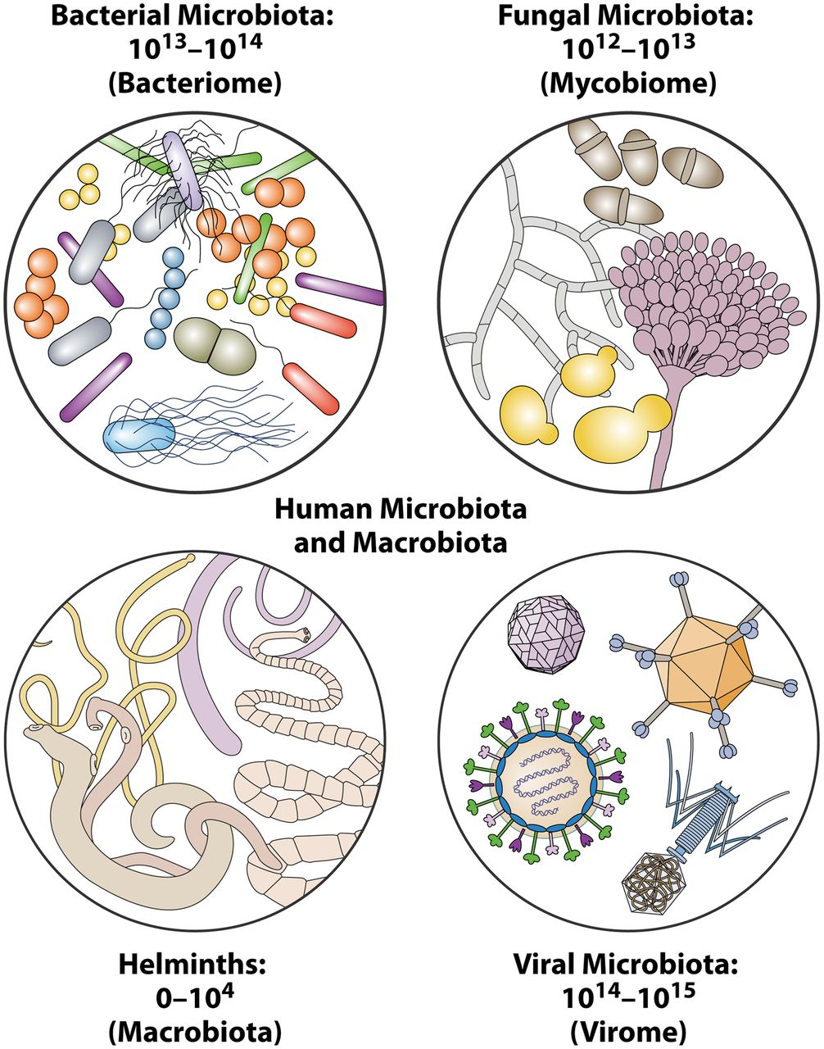
Introduction
Microbiomes
Gut microbiome
Dysbiosis
Antibiotics
Effects on microbiome health
Rowan-Nash, A. D., Korry, B. J., Mylonakis, E., & Belenky, P. (2019). Cross-domain and viral interactions in the microbiome. Microbiology and Molecular Biology Reviews, 83(1).

Slide 3
Introduction
Microbial diversity
Gut diversity and health
Fungi
under-researched
Small percentage of total microbiota
Archaea
Morphology and metabolics
Commensals in human microbiome

Slide 4
Review of Literature
Dysbiosis in the gut microbiome is linked with immunological and neurological diseases¹.
Gilbert, J. A., Quinn, R. A., Debelius, J., Xu, Z. Z., Morton, J., Garg, N., ... & Knight, R. (2016). Microbiome-wide association studies link dynamic microbial consortia to disease. Nature, 535(7610), 94-103.

Slide 5
Review of Literature
The long-term effects of antibiotic usage may include an increased risk of infection¹ and metabolic diseases².
Cox, L. M., & Blaser, M. J. (2015). Antibiotics in early life and obesity. Nature Reviews Endocrinology, 11(3), 182.
Langdon, A., Crook, N., & Dantas, G. (2016). The effects of antibiotics on the microbiome throughout development and alternative approaches for therapeutic modulation. Genome medicine, 8(1), 39.

Slide 6
Review of Literature
Fungi-related dysbiosis of the gut microbiome has been associated with diabetes¹ and keratitis².
Al Bataineh, M. T., Dash, N. R., Lassen, P. B., Banimfreg, B. H., Nada, A. M., Belda, E., & Clément, K. (2020). Revealing links between gut microbiome and its fungal community in Type 2 Diabetes Mellitus among Emirati subjects: A pilot study. Scientific reports, 10(1), 1-11.
Jayasudha, R., Chakravarthy, S. K., Prashanthi, G. S., Sharma, S., Garg, P., Murthy, S. I., & Shivaji, S. (2018). Alterations in gut bacterial and fungal microbiomes are associated with bacterial Keratitis, an inflammatory disease of the human eye. Journal of biosciences, 43(5), 835-856.

Slide 7
Review of Literature
Microbial composition of the gut microbiome changes during antibiotic exposure
There are bacteria linked with low diversity and longer recovery from antibiotic exposure
Raymond, F., Ouameur, A. A., Déraspe, M., Iqbal, N., Gingras, H., Dridi, B., ... & Frenette, J. (2016). The initial state of the human gut microbiome determines its reshaping by antibiotics. The ISME journal, 10(3), 707-720.

Slide 8
Hypothesis
There are fungal species associated with recovery from cefprozil exposure

Slide 9
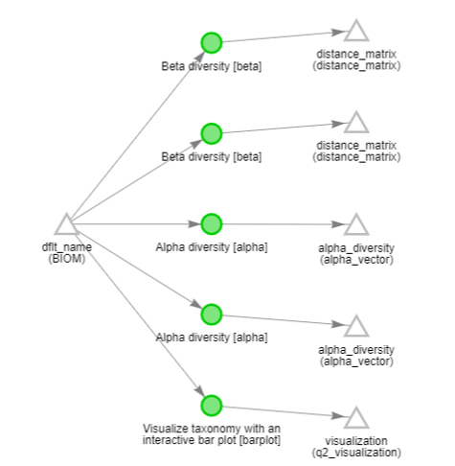
Methodology
Data accession¹
Qiita²
Analysis Creation
Gut microbiota
Alpha Diversity
Raymond, F., Ouameur, A. A., Déraspe, M., Iqbal, N., Gingras, H., Dridi, B., ... & Frenette, J. (2016). The initial state of the human gut microbiome determines its reshaping by antibiotics. The ISME journal, 10(3), 707-720.
Gonzalez, A., Navas-Molina, J. A., Kosciolek, T., McDonald, D., Vázquez-Baeza, Y., Ackermann, G., ... & Sanders, J. G. (2018). Qiita: rapid, web-enabled microbiome meta-analysis. Nature methods, 15(10), 796-798.

Slide 10
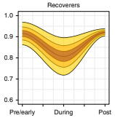
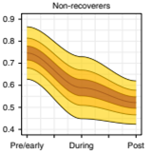
Methodology
Recoverers vs Non-recoverers
Alpha diversity
Recovery-Associated Microbiota
Student’s t-test
Chng, K. R., Ghosh, T. S., Tan, Y. H., Nandi, T., Lee, I. R., Ng, A. H. Q., ... & Barkham, T. (2020). Metagenome-wide association analysis identifies microbial determinants of post-antibiotic ecological recovery in the gut. Nature Ecology & Evolution, 4(9), 1256-1267.

Slide 11
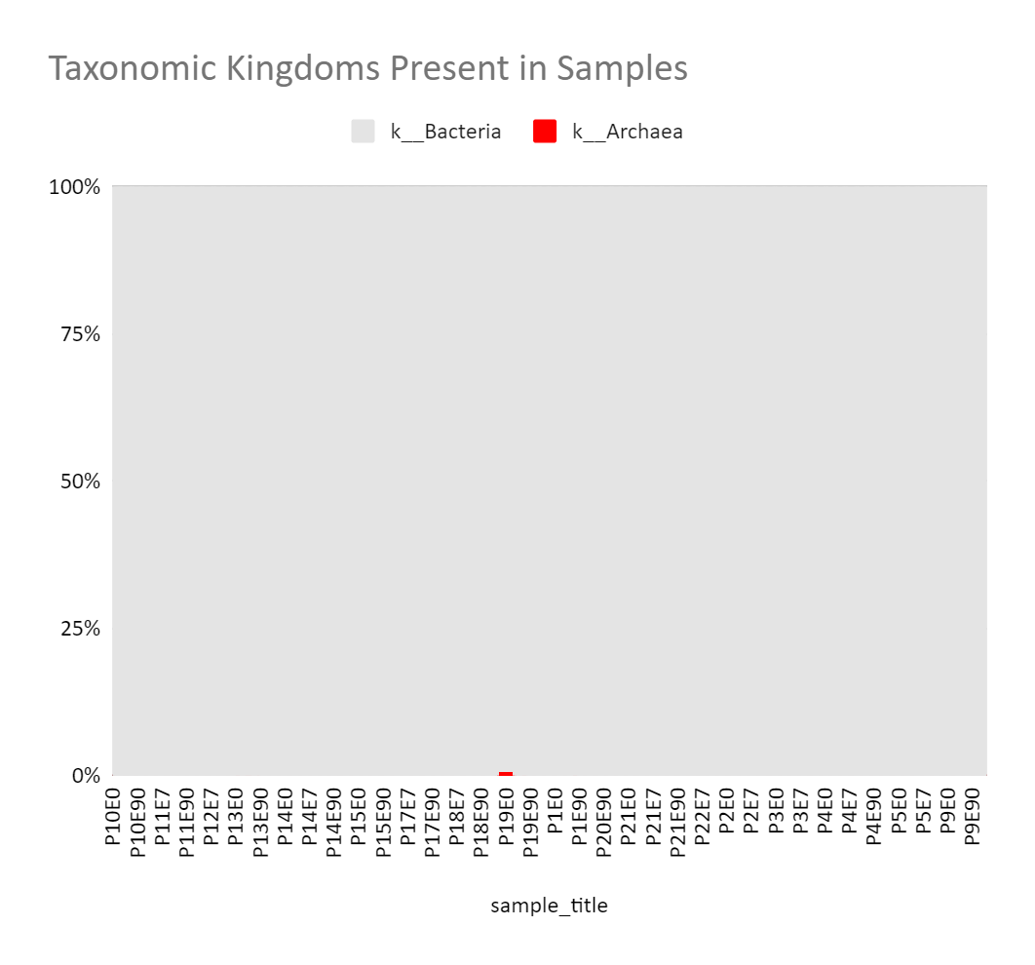
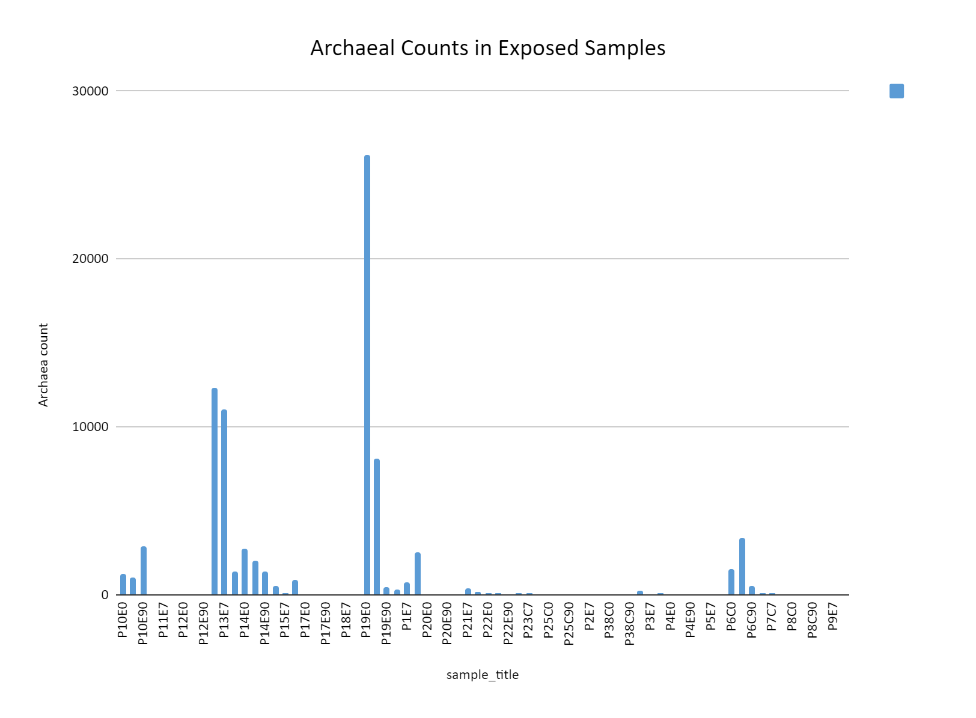
Results: Gut Microbiota

Slide 12
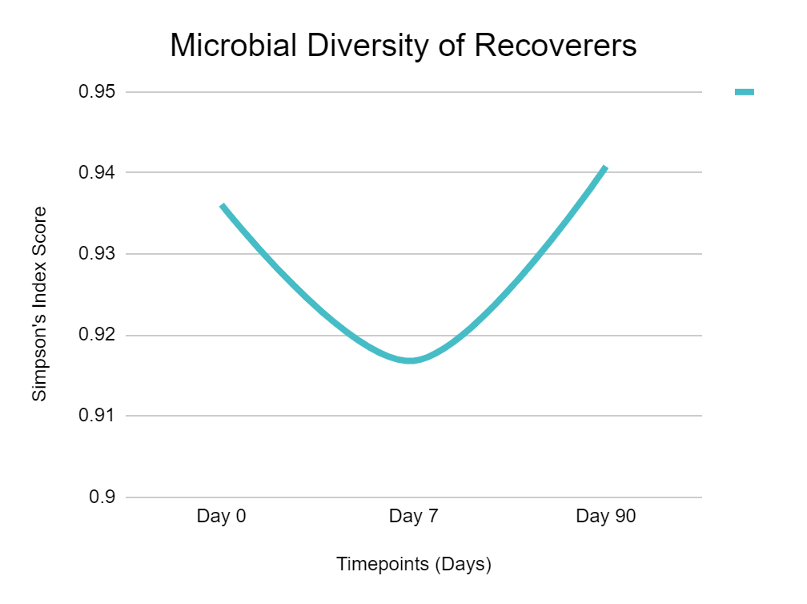
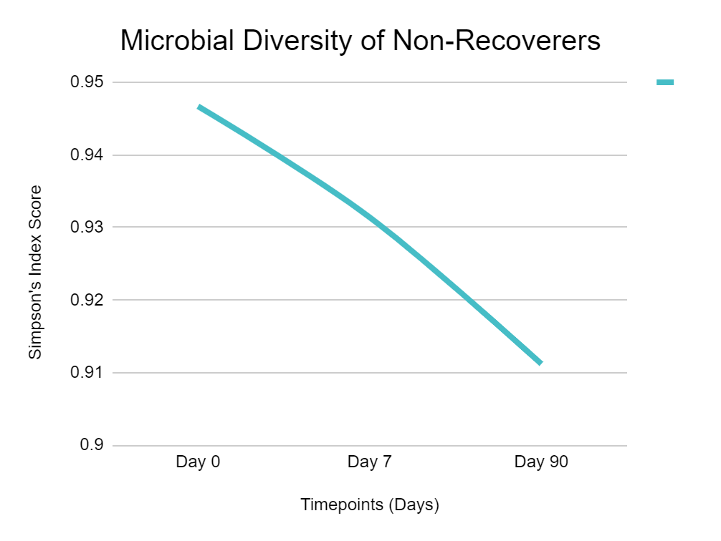
Results: Microbial Diversity
Recoverers: P2, P9, P10, P11, P12, P13, P17, P21, P22
Non-Recoverers: P1, P5, P15, P18, P19, P20

Slide 13
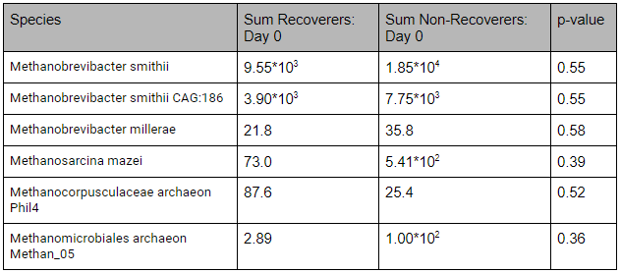
Results: Day 0

Slide 14
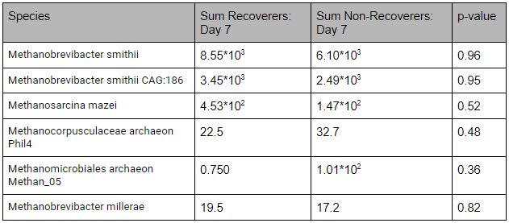
Results: Day 7

Slide 15
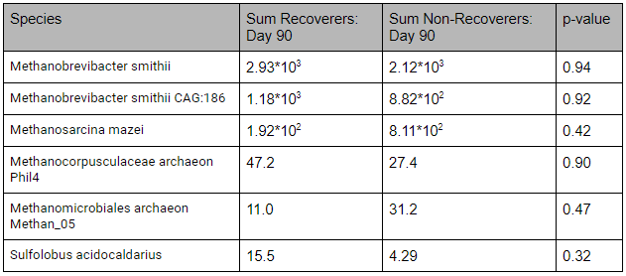
Results: Day 90

Slide 16
Discussion
Interesting cases: alpha diversity
Sample P3
Diversity jumps during course
Sample P4
Large increase from pre- to post-exposure
Sample P14
During course and post-exposure diversity

Slide 17
Discussion
No fungi found in samples
Hypothesis not supported
Possible Explanations
Mislabeled data
16S, Metagenomics
Unrecognizable species
Not normal microbiota

Slide 18
Discussion
Archaea present in samples
0-1% of all microbiota
Methanobrevibacter smithii most prevalent throughout samples
Consistent with Miller, T. L. 1982
No significant difference between archaeal counts
Null hypothesis accepted

Slide 19
Conclusion
Hypothesis not supported
No relevant fungi, no relevant archaea
Future Work
Focus on archaea as a whole
Study absence of fungi

Slide 20
Acknowledgements
My parents
Dr Anthony Hay
Mr Seweryn
The Qiita Support Team

Slide 21
References
Gonzalez, A., Navas-Molina, J. A., Kosciolek, T., McDonald, D., Vázquez-Baeza, Y., Ackermann, G., ... & Sanders, J. G. (2018). Qiita: rapid, web-enabled microbiome meta-analysis. Nature methods, 15(10), 796-798.
Raymond, F., Ouameur, A. A., Déraspe, M., Iqbal, N., Gingras, H., Dridi, B., ... & Frenette, J. (2016). The initial state of the human gut microbiome determines its reshaping by antibiotics. The ISME journal, 10(3), 707-720.
Cox, L. M., & Blaser, M. J. (2015). Antibiotics in early life and obesity. Nature Reviews Endocrinology, 11(3), 182.
Langdon, A., Crook, N., & Dantas, G. (2016). The effects of antibiotics on the microbiome throughout development and alternative approaches for therapeutic modulation. Genome medicine, 8(1), 39.
Al Bataineh, M. T., Dash, N. R., Lassen, P. B., Banimfreg, B. H., Nada, A. M., Belda, E., & Clément, K. (2020). Revealing links between gut microbiome and its fungal community in Type 2 Diabetes Mellitus among Emirati subjects: A pilot study. Scientific reports, 10(1), 1-11.
Jayasudha, R., Chakravarthy, S. K., Prashanthi, G. S., Sharma, S., Garg, P., Murthy, S. I., & Shivaji, S. (2018). Alterations in gut bacterial and fungal microbiomes are associated with bacterial Keratitis, an inflammatory disease of the human eye. Journal of biosciences, 43(5), 835-856.

Slide 22
References
Miller, T. L., Wolin, M. J., de Macario, E. C., & Macario, A. J. (1982). Isolation of Methanobrevibacter smithii from human feces. Applied and environmental microbiology, 43(1), 227-232.
Gilbert, J. A., Quinn, R. A., Debelius, J., Xu, Z. Z., Morton, J., Garg, N., ... & Knight, R. (2016). Microbiome-wide association studies link dynamic microbial consortia to disease. Nature, 535(7610), 94-103.
Chng, K. R., Ghosh, T. S., Tan, Y. H., Nandi, T., Lee, I. R., Ng, A. H. Q., ... & Barkham, T. (2020). Metagenome-wide association analysis identifies microbial determinants of post-antibiotic ecological recovery in the gut. Nature Ecology & Evolution, 4(9), 1256-1267.

